Slide 1
Factors That Drive Home Prices
Hanna Humphrey
Data Analytics, Thinkful
Capstone II
09/2022

Slide 2
INTRODUCTION
The team at our investment bank wants to understand how it should allocate dollars earmarked for investment into mortgage-backed securities.
For the sake of ensuring a solid investment, the team wants to know what factors drive home prices.
Factors analyzed included: Overall Quality rating of the home, number of cars the garage holds, and the month sold.

Slide 3
DATA
The data set was a sample of 1460 houses in Ames, Iowa sold from 2006 - 2010.
Data includes 1461 rows of data and 82 columns.
Descriptive Statistics confirm normal distribution for Overall Quality, Garage Cars, and Month Sold.
There is a positive correlation with Sales Price and Overall Quality, Garage Cars, and Month Sold.

Slide 4
HYPOTHESES
Overall Rating
Garage Cars
Month Sold
H₁ There is no significant difference in sales price between homes that have a 10 overall quality rating and a home that has an 5 overall quality rating.
H₂ There is no significant difference in sales price between homes that have a 10 overall quality rating and a home that has an 9 overall quality rating.
H₁ There is no significant difference in sales price between homes that have one car garages versus homes that have two car garages.
H₂ There is no significant difference in sales price between homes that have three car garages versus homes that have two car garages.
H₁ There is no significant difference in sales price between homes that are sold in January versus homes that are sold in December.
H₂ There is no significant difference in sales price between homes that are sold in April versus homes that are sold in September.

Slide 5
METHOD
Confirmed normal distribution using Descriptive Statistics
Split data into sample populations using pivot table filters
Used Analysis Toolpak’s Two-Sample t-Test Assuming Unequal Variances
Notes:
3. to look for statistical significance in populations for H₁ and H₂.
4. to compare care makes and their Annual Fuel Costs and Tailpipe CO2 emissions.

Slide 6
RESULTS

Slide 7
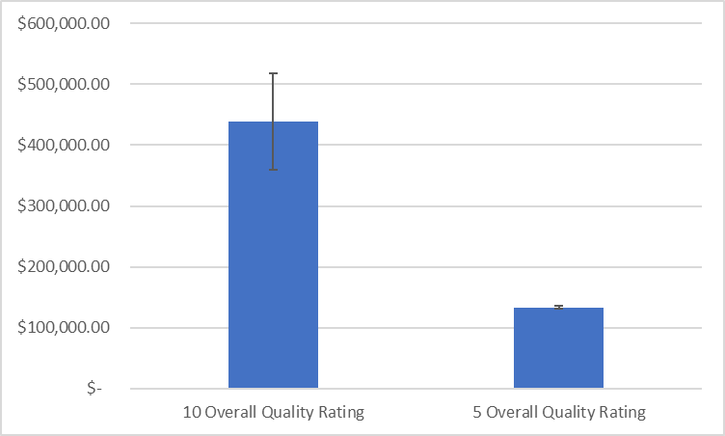
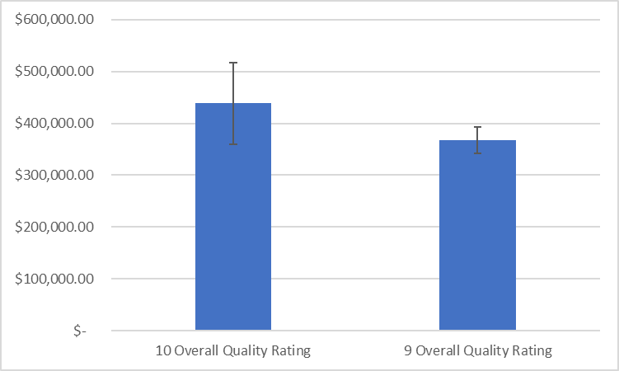
Overall Quality
There is significant difference in sales price between homes with an overall quality of 10 versus homes with an overall quality of 5.
The 95% confidence interval is between $225,553.76 and $384,576.32.
There is no significant difference in sales price between homes with an overall quality of 10 versus homes with an overall quality of 9.
The 95% confidence interval is between $(11,379.23) and $153,529.96.
Notes:
Compact Observations: 5,508
Midsize Observations: 4,395
P-value - 1.51947E-64

Slide 8
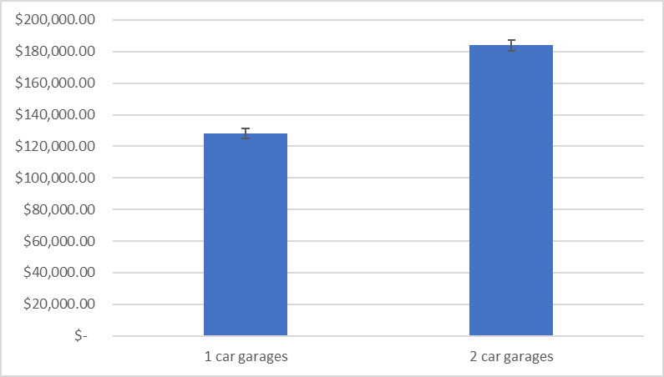
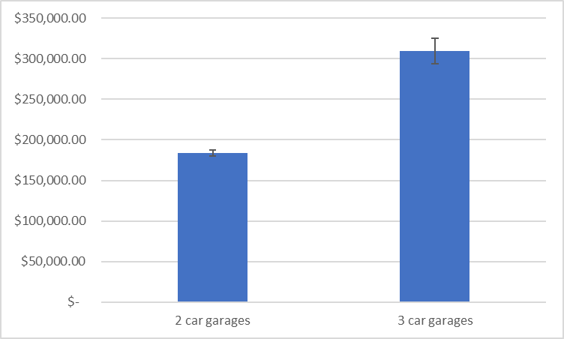
Garage Cars
There is significant difference in sales price between homes with a 1 car garage versus a 2 car garage.
The 95% confidence interval is between $(60,435.84) and $(51,034.11).
There is significant difference in sales price between homes with a 2 car garage versus a 3 car garage.
The 95% confidence interval is between $(141,839.89) and $(109,729.03).
Notes:
Compact Observations: 5,508
Midsize Observations: 4,395
P-value - 1.51947E-64

Slide 9
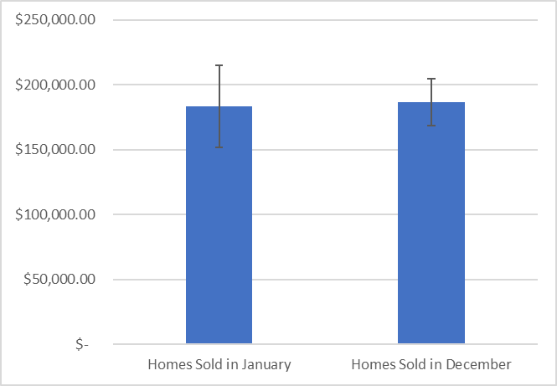
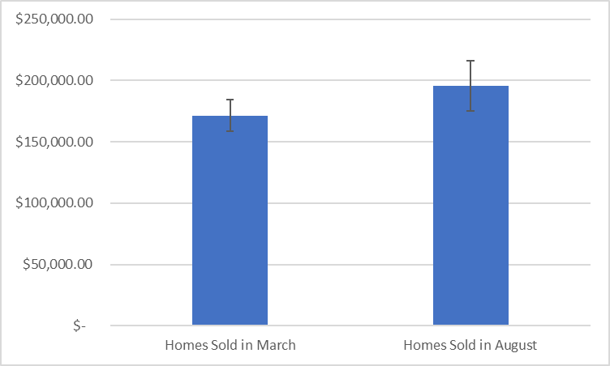
Months Sold
There is no significant difference in sales price between homes sold in January versus December.
The 95% confidence interval is between $(39,672.59) and $33,147.18.
There is no significant difference in sales price between homes sold in March versus August.
The 95% confidence interval is between $(48,604.15) and $244.26.
Notes:
Compact Observations: 5,508
Midsize Observations: 4,395
P-value - 1.51947E-64

Slide 10
RECOMMENDATIONS
Invest in homes that have overall ratings of both 9 and 10, but it is recommended to invest in 10 rating since they have the highest sales price.
Invest in homes that have 3 car garages.

Slide 11
OTHER RESOURCES
Click to see the Factors That Drive Home Prices Excel Workbook Here

Slide 12
QUESTIONS

